Slide 1
The Respiratory System

Slide 2
Objective:
Identify the main components of the respiratory system and their function.

Slide 3
Overall function of the Respiratory System
  Air Distributor
  Gas exchanger
  Filter and air warmer
  Influences speech
  Allows for sense of smell

Slide 4
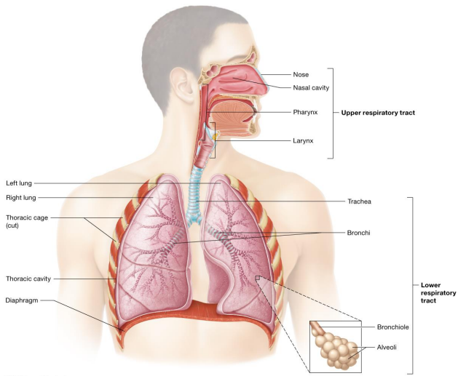
Organs of the respiratory system

Slide 5
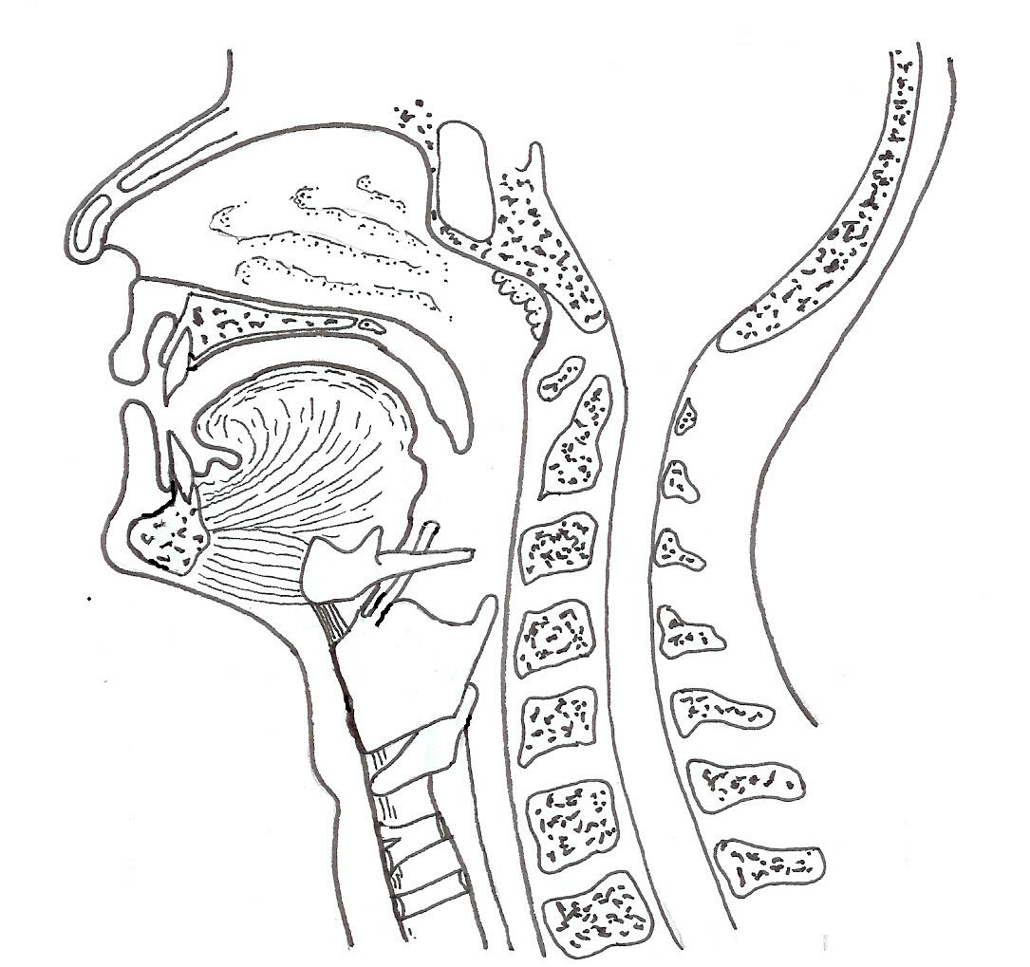
The head (cross section)
Nasal cavity
Soft palate
Pharynx
Epiglottis
Larynx
Trachea

Slide 6
Must know organs list
Mouth
Pharynx
Larynx
Trachea
Epiglottis
Bronchi
Bronchiole
Alveoli

Slide 7
The nose (nasal cavity)
Air enters and leaves the body through the nose
Here it is cleaned, warmed and moistened before entering the body
The nasal secretions contain an anti-bacterial enzyme.

Slide 8
The mucous lining
The nasal cavity and upper airways have a mucous lining and hairs
The function of mucus is to trap dirt particles and microbes before they enter the lungs

Slide 9
Epiglottis - flap of skin (hatch) on trachea, moves when swallowing and speaking. Closes off trachea when swallowing food.
The entrance to the larynx is protected by the epiglottis.
Trachea (windpipe) Consists of smooth cartilage and C shaped rings of cartilage for added support.

Slide 10
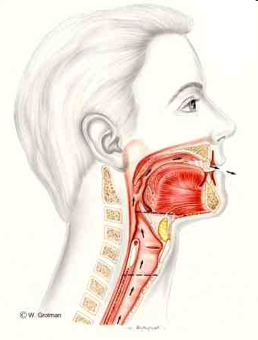
The larynx (Adam’s apple or voice box)
The larynx is structure at entrance to the trachea and lungs
The larynx houses the vocal cords

Slide 11
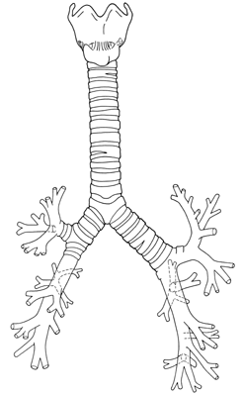
The bronchial tree
Larynx
Trachea
Bronchi
Bronchiole
The Sourcebook of Medical Illustration (The Parthenon Publishing Group, P. Cull, ed., 1989)

Slide 12
Trachea & bronchi
The trachea & bronchi are reinforced with C-shaped rings of cartilage
(these prevent the tubes collapsing during inhalation)
Is lined by tiny hair like structures called Cilia (keeps airways clean)

Slide 13
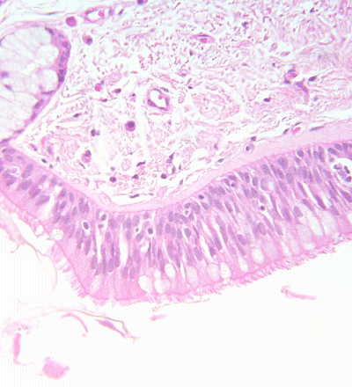
The ciliated lining tissue
Mucus-secreting goblet cells
Cilia
        G. Meyer, ANHB-UWA,

Slide 14
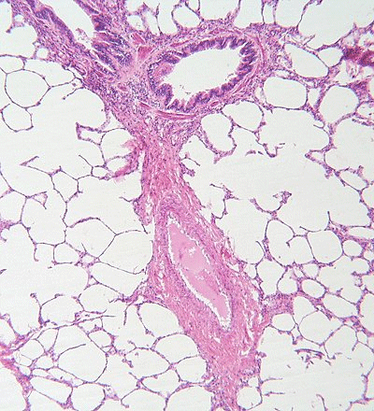
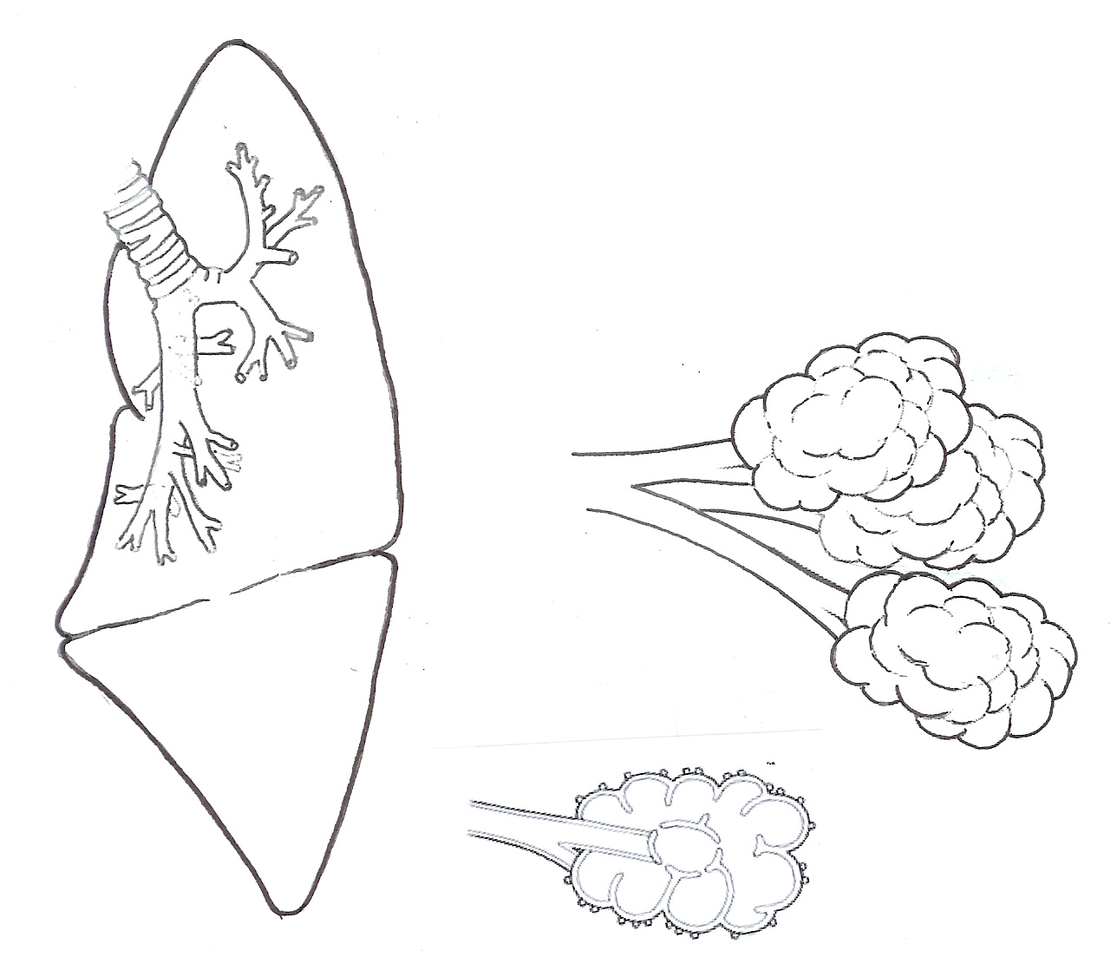
Alveoli
Alveoli
        G. Meyer, ANHB-UWA,
The bronchioles end with microscopic clusters of air sacs – the alveoli
Gas exchange takes place in the alveoli

Slide 15
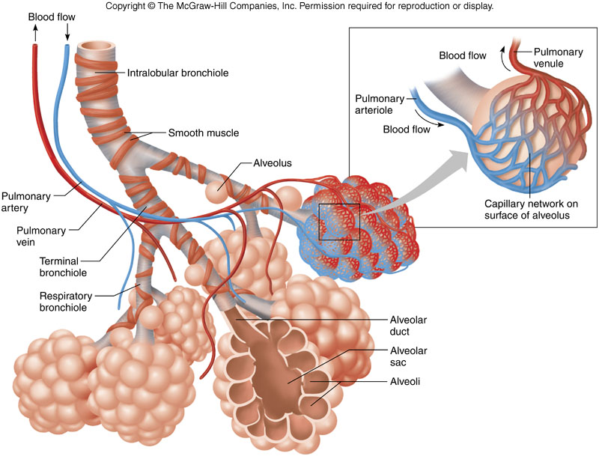

Slide 16
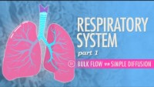
https://www.youtube.com/watch?v=bHZsvBdUC2I

